Slide 1
Academic Activities Management System For KFS University
Supervised by:
Dr/ Diana Tharwat
Dr/ Amena Ramadan

Slide 2
Meet Our Team
Mohamed Abd – El Hafez Mobark
Hussein Tarek Hassan
Mohamed Ali Abd – Elatif
Anas Ahmed Abd – EL Kader
Mohamed Awad Fahmy
Ahmed Mohamed Selim
Mohamed Abo El Azm

Slide 3

Outline
Introduction
Problem Definition
Proposed system features
Methodology
UML models
ER – Diagrams
Results
Conclusion
Future Work

Slide 4
Introduction
Now a day’s education plays a significant role in development of any country.
Many of education organizations try to increase education quality. One of the aspects of this improvement is managing of university resources.
KFS university is a web application that helps professors and students to improve the learning process of all students in the university that facilitate the process of communication between professors and students.
KFS University Management System is such a service which provides all services for an educational institute to make your life easier and faster.

Slide 5
Problem Definition
Less Security.
Time – consuming for students to enroll courses.
Difficulty for visitors to know the university events and news.
Risk of missing exam sheets.
After the covid – 19 pandemic ,its clearly that the educational system will not the same again.

Slide 6
Proposed system features
The common features of the project are:
• This is quite easy to use for each user.
• Increase efficiencies and reduce costs.
• Easy account maintenance.
• Easy attendance process.
• Attendance history.
• Easy online exam process.
• Exam history.

Slide 7
Methodology
Divided into three main modules
Administrator
Create Pages, Assign courses
Professor
Create exams, upload lectures and approve student’s request for courses
Student
Create post, Download lectures

Slide 8
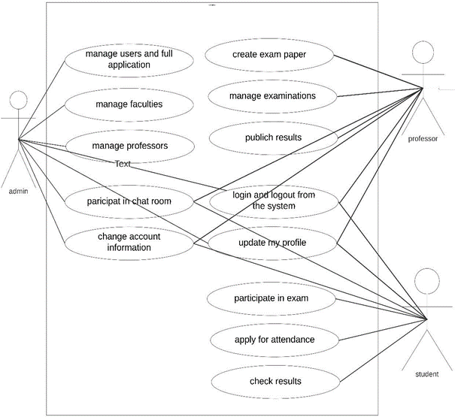
UML Models
KFS university Use Cases Diagram

Slide 9
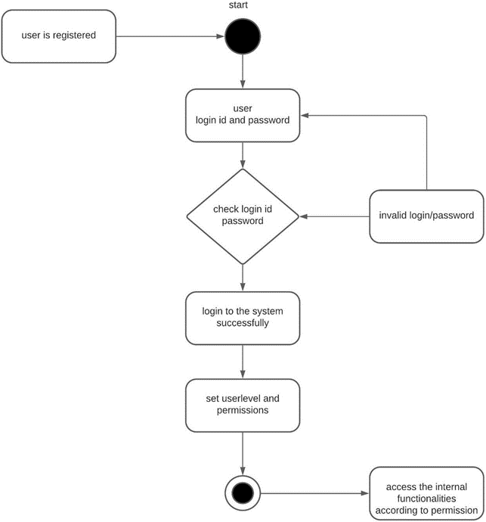
UML Models
KFS University activity diagram login process

Slide 10
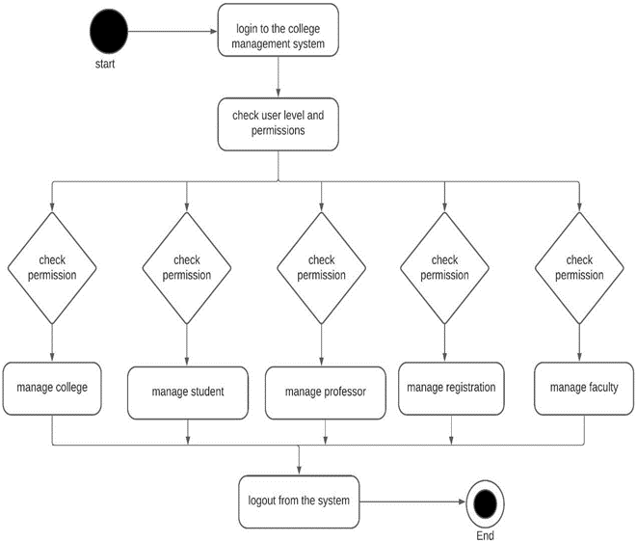
UML Models
KFS University activity diagram permission

Slide 11
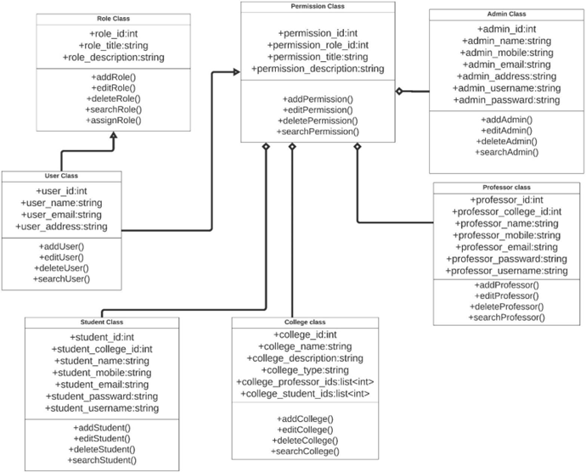
UML Models
KFS University Class diagram

Slide 12
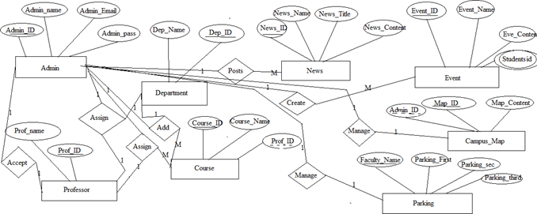
E-R diagrams
KFS University System ER-Diagram – admin authorizations

Slide 13
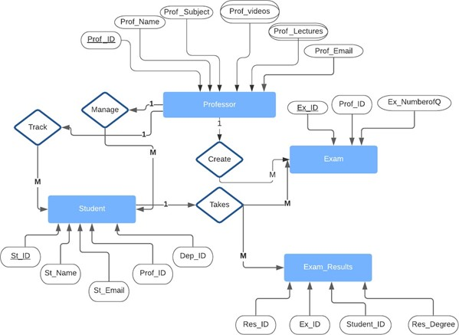
E-R diagrams
KFS University System ER-Diagram – professor

Slide 14
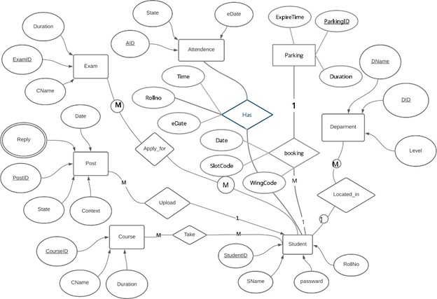
E-R diagrams
KFS University System ER-Diagram – student

Slide 15

KFS University Management System

Slide 16




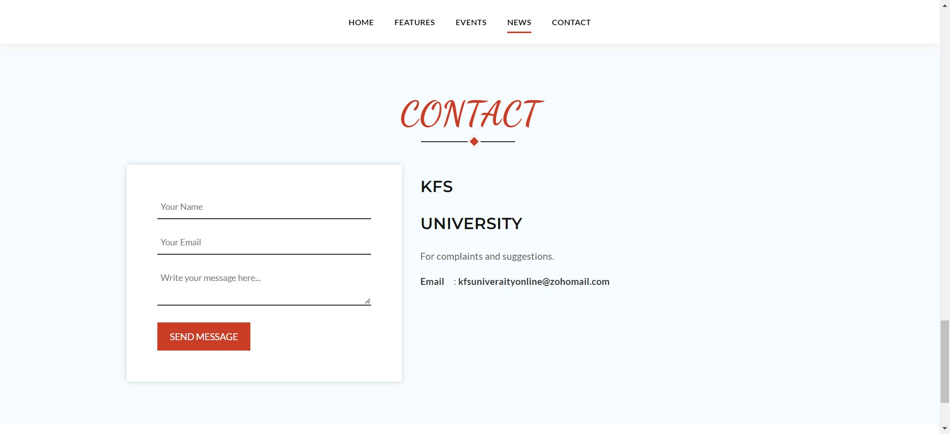

Home Page

Slide 17

Register Page

Slide 18

Login Page

Slide 19
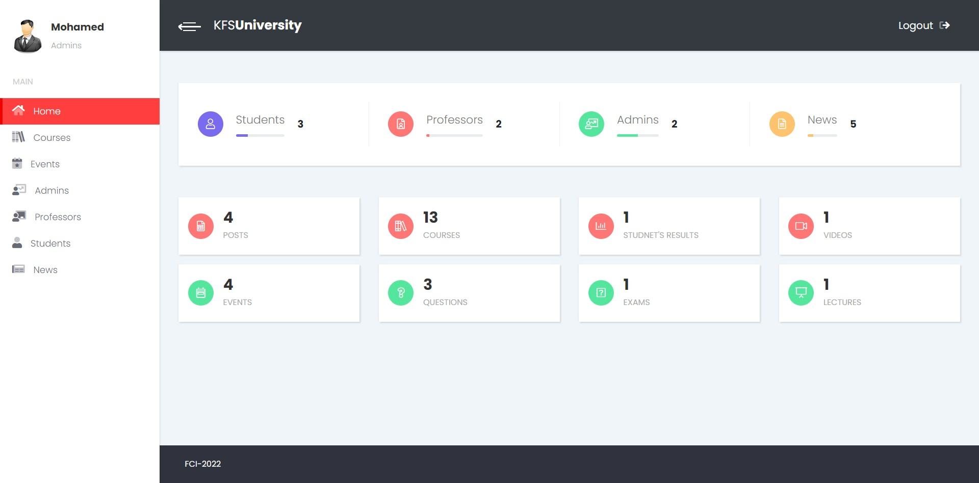
Admin Home page

Slide 20
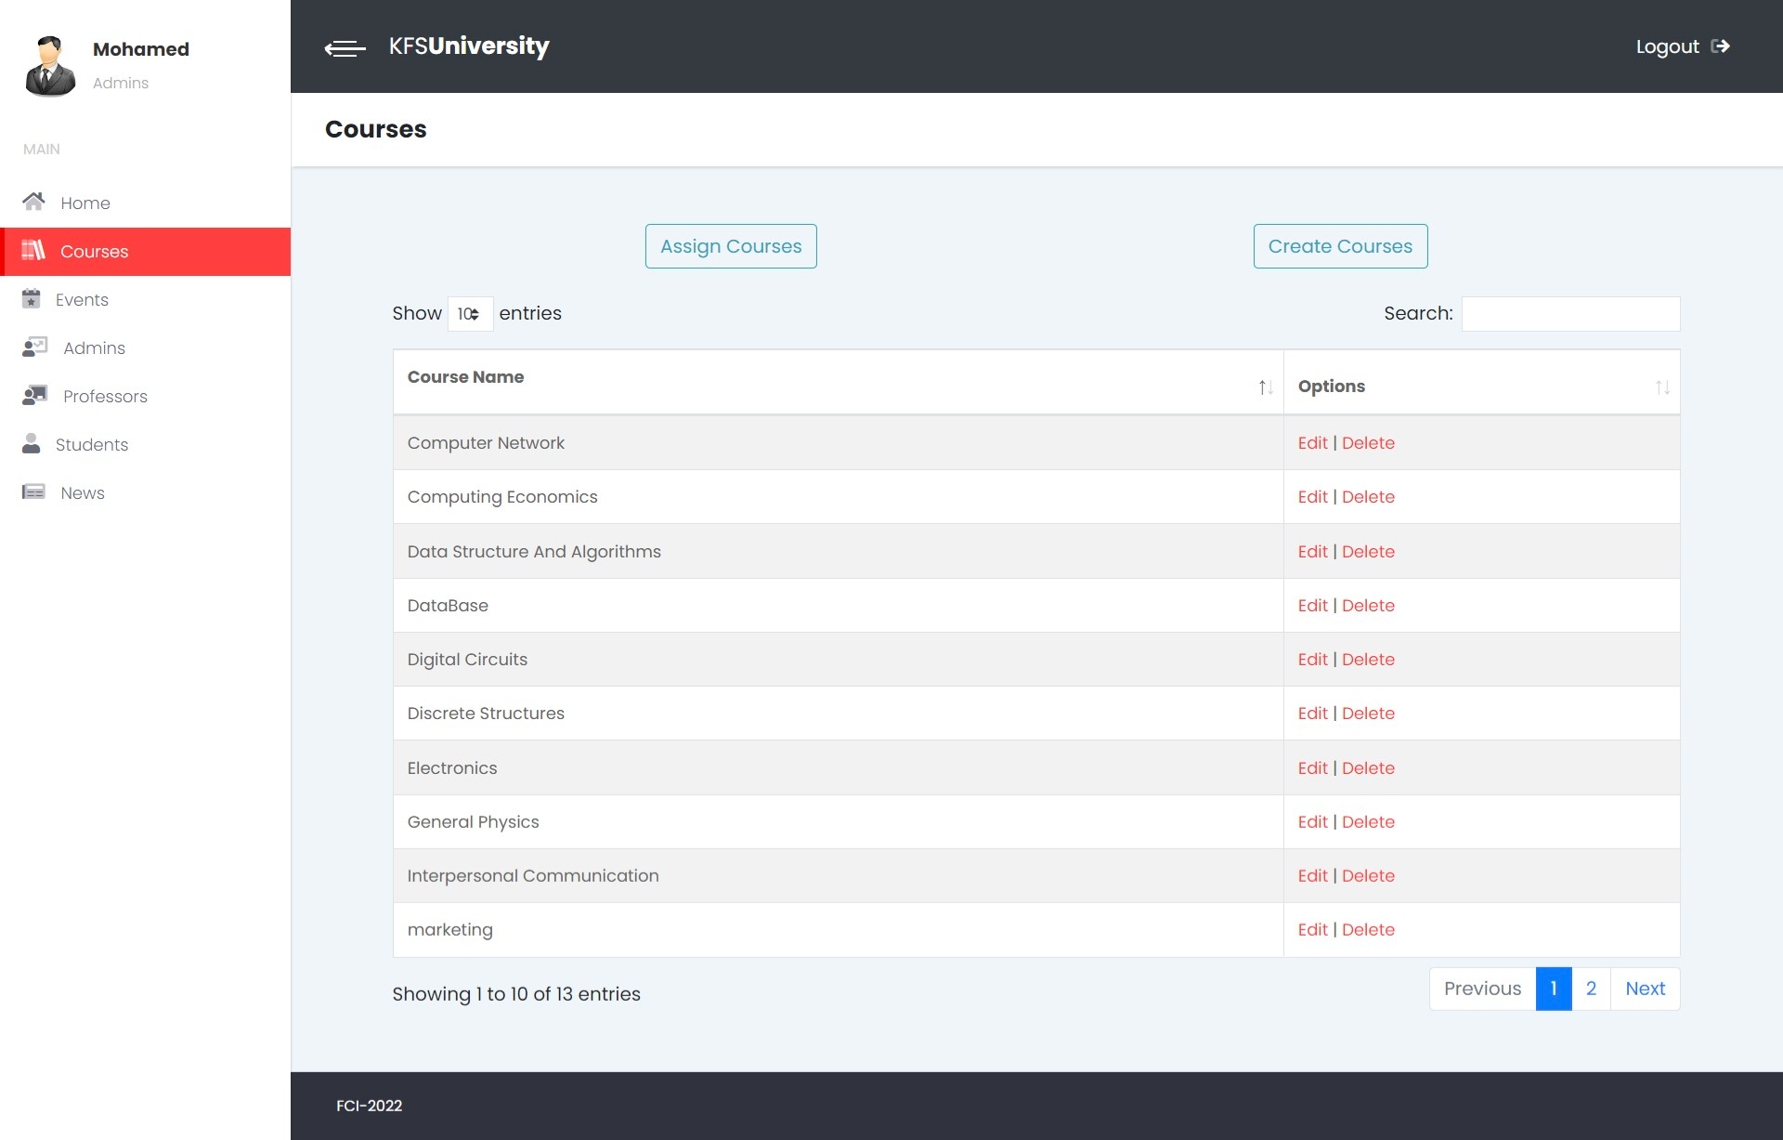
Admin Home Create Course page

Slide 21
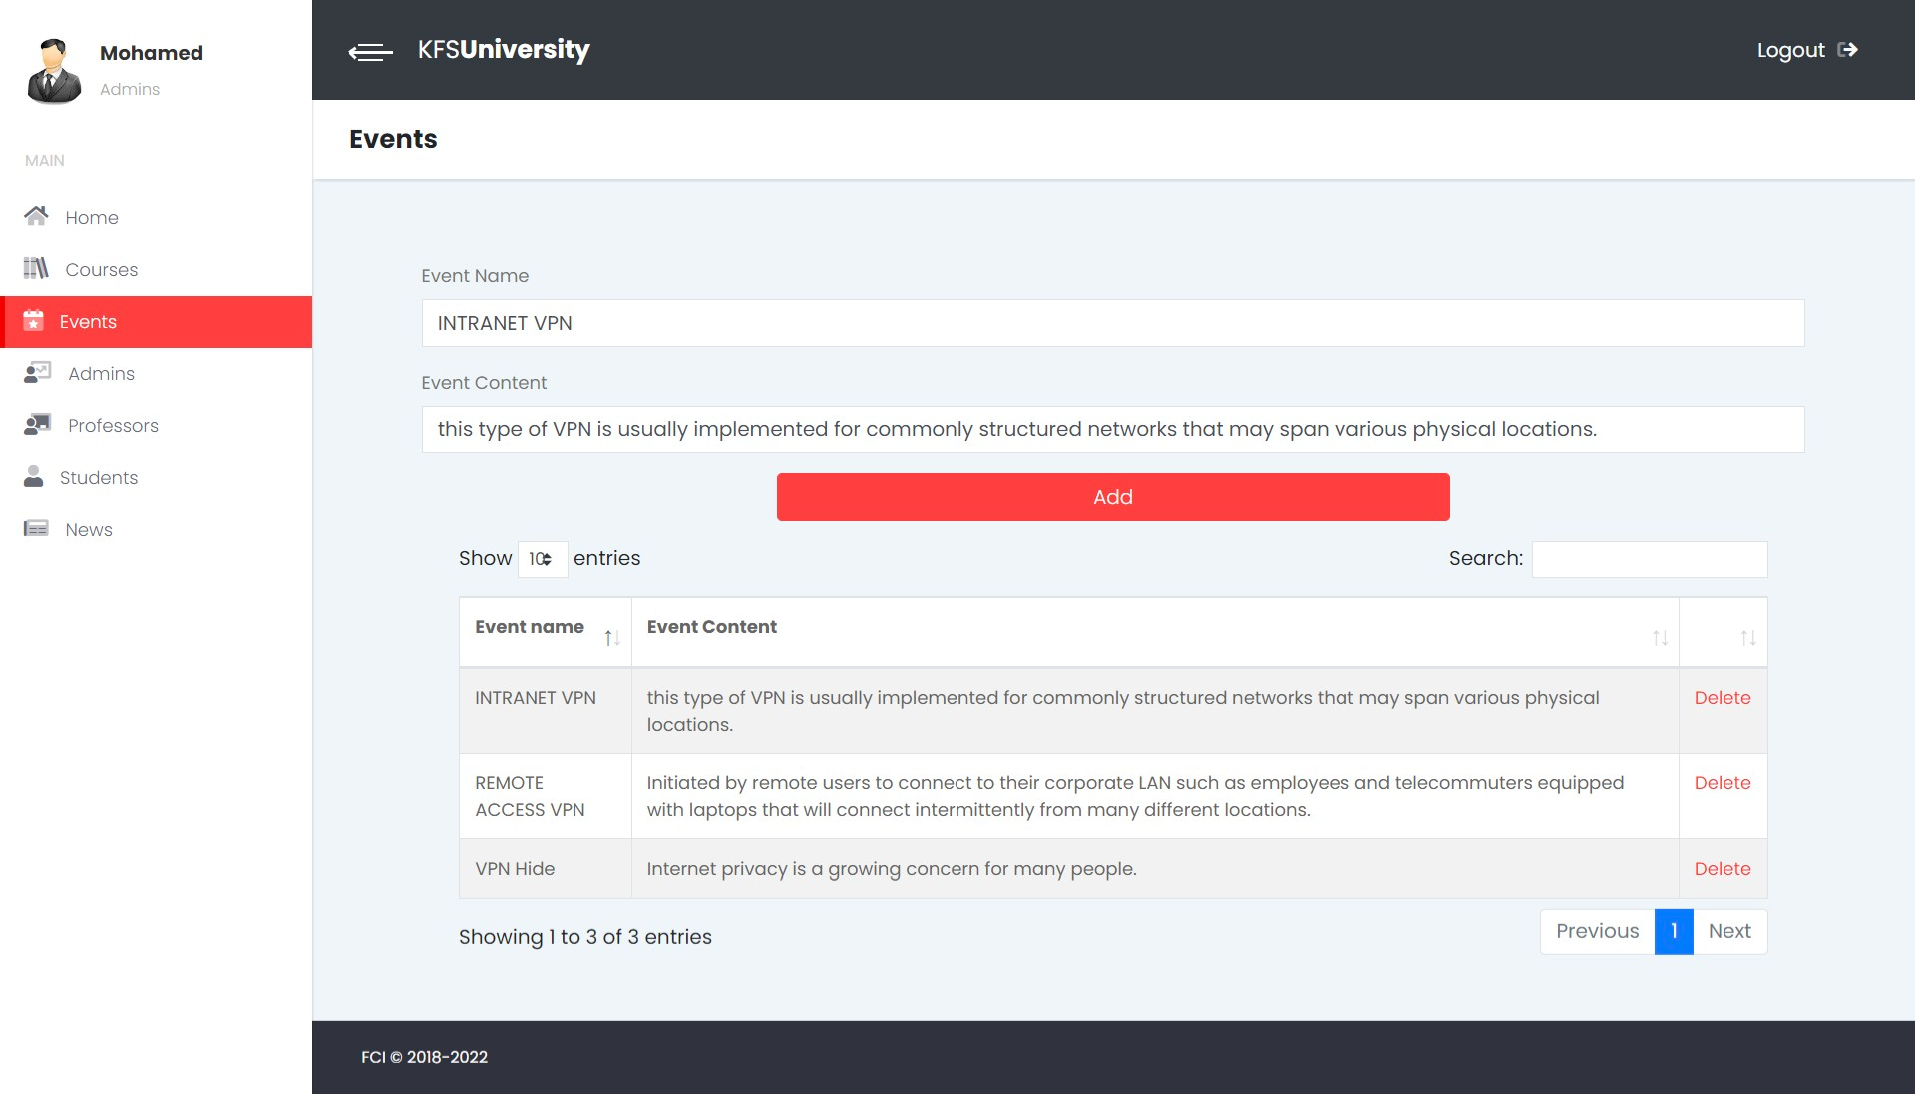
Admin Create Event page

Slide 22
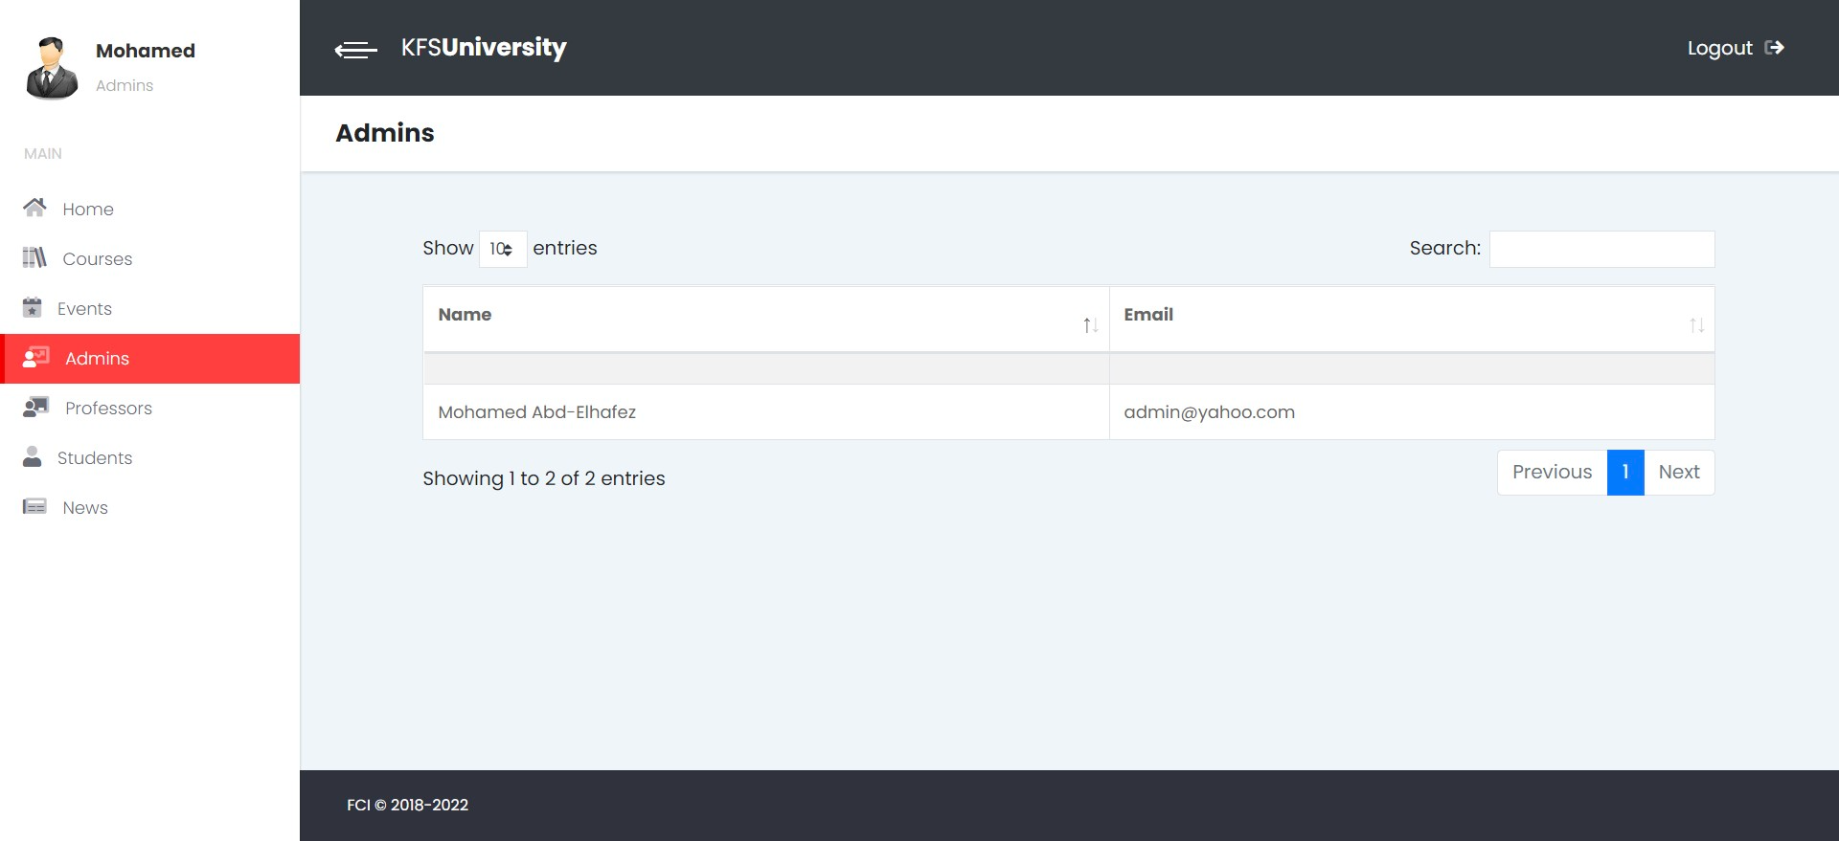
Show All Admins Accounts

Slide 23
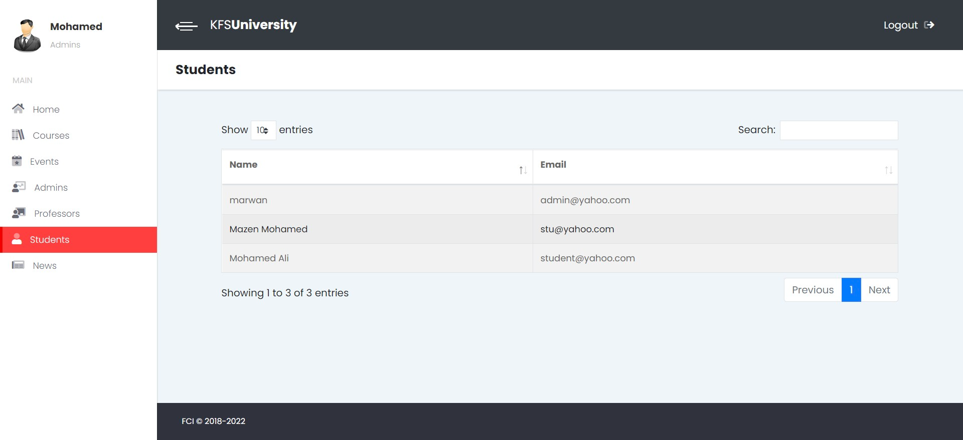
Show All Students Accounts

Slide 24
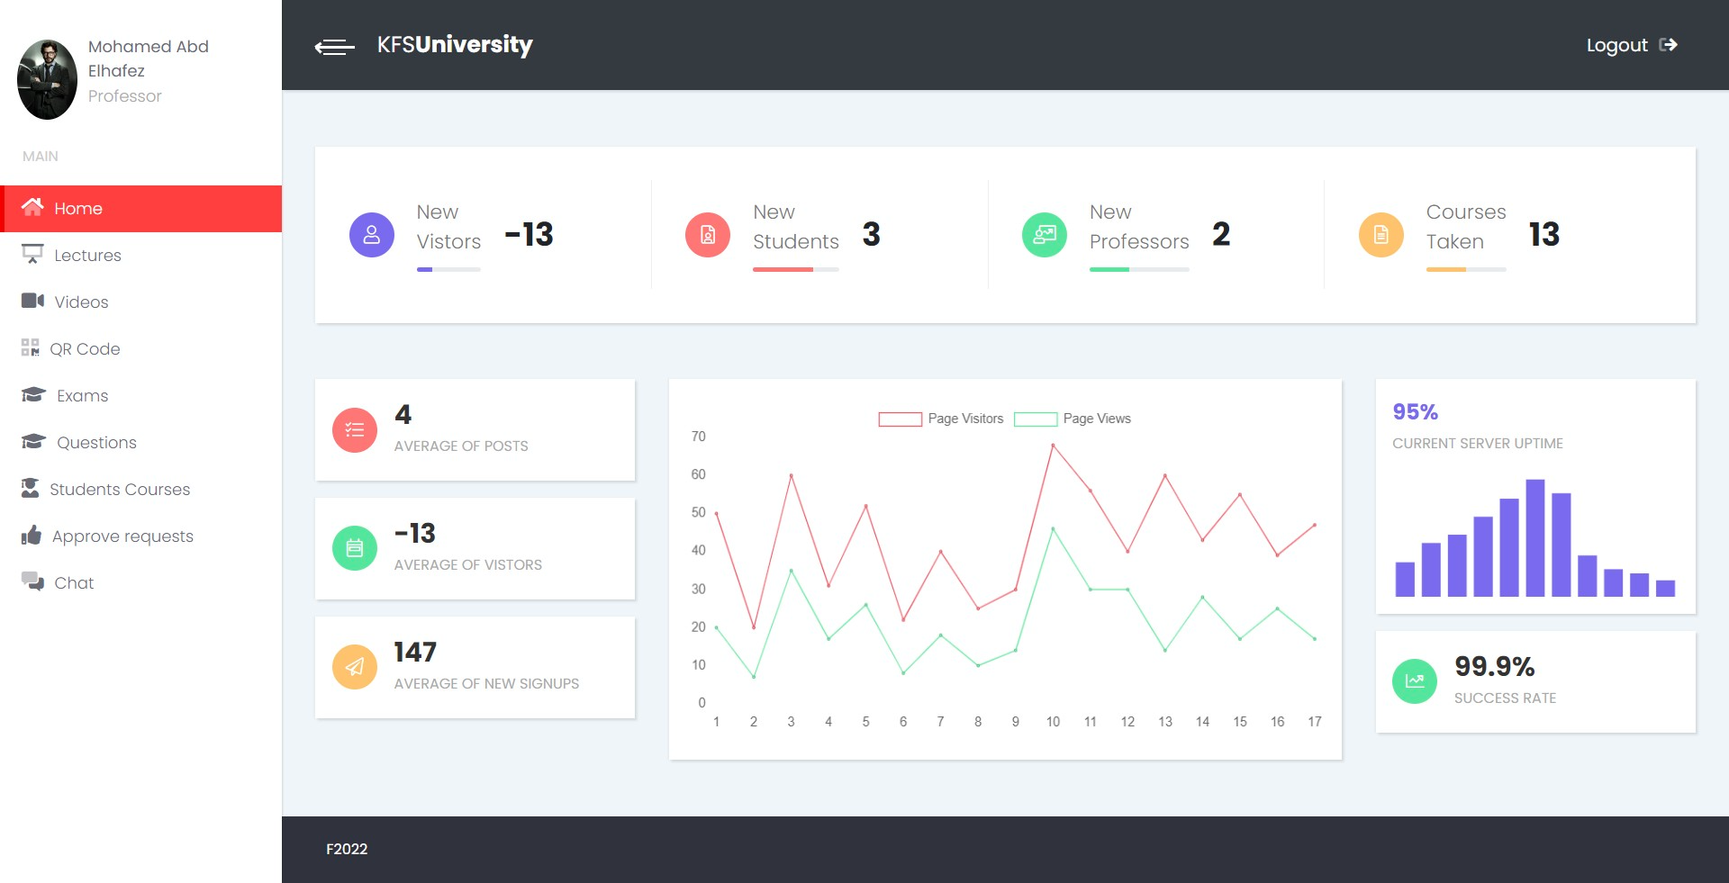
Professor Home Page

Slide 25
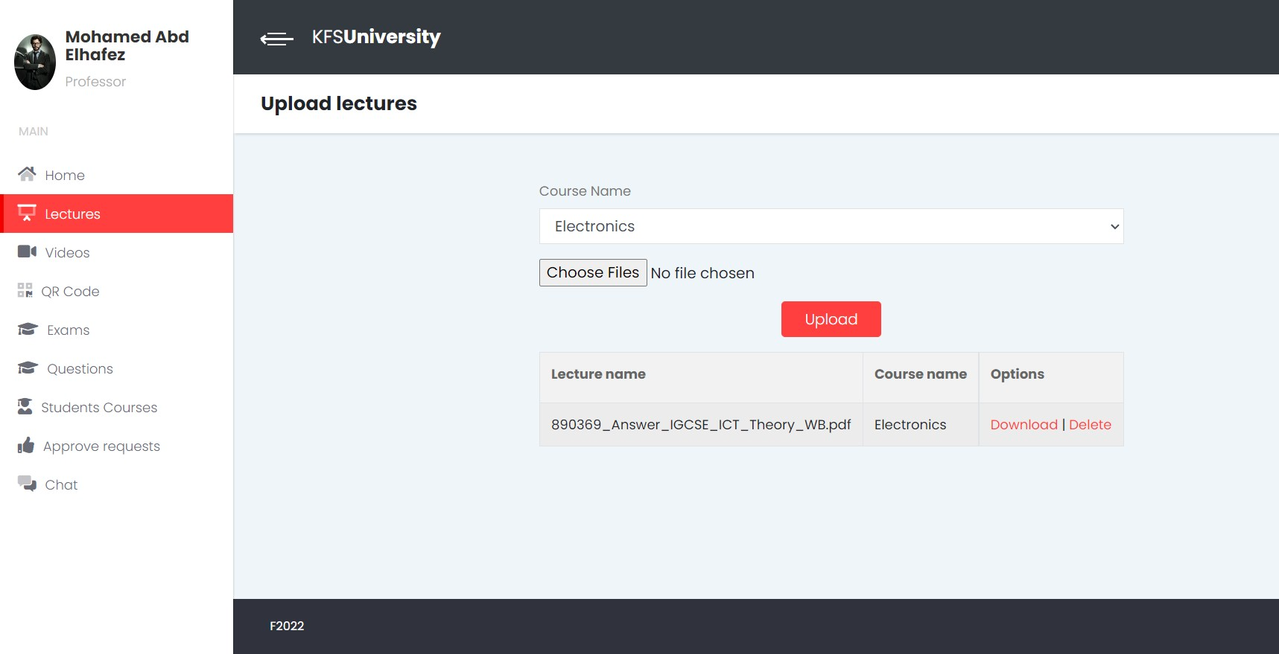
Upload lectures

Slide 26
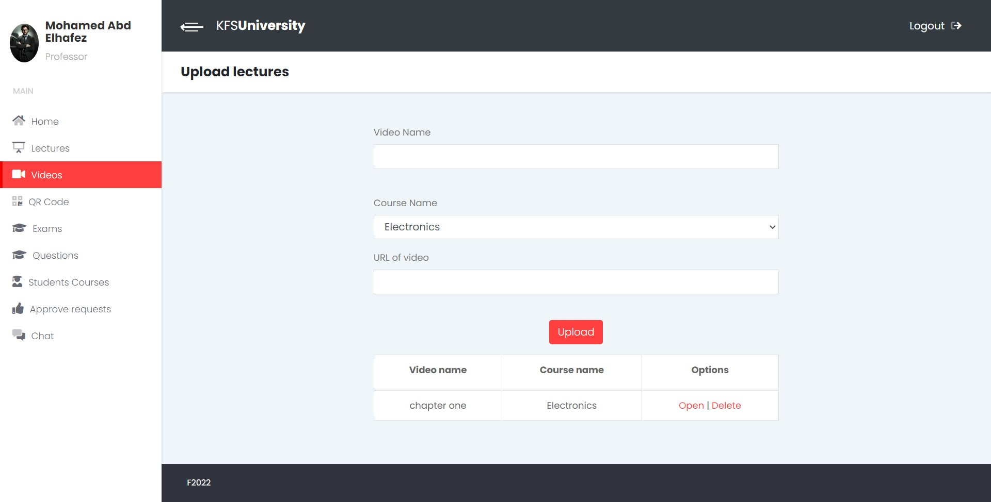
Upload A Video

Slide 27
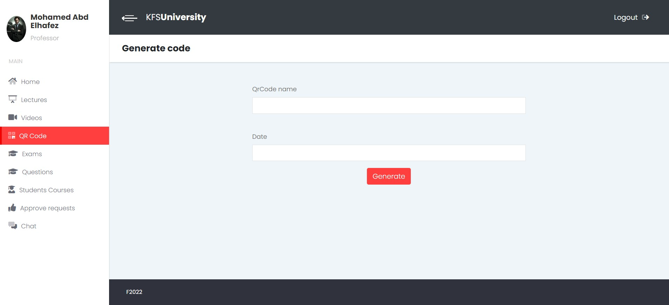
Create A QR code

Slide 28
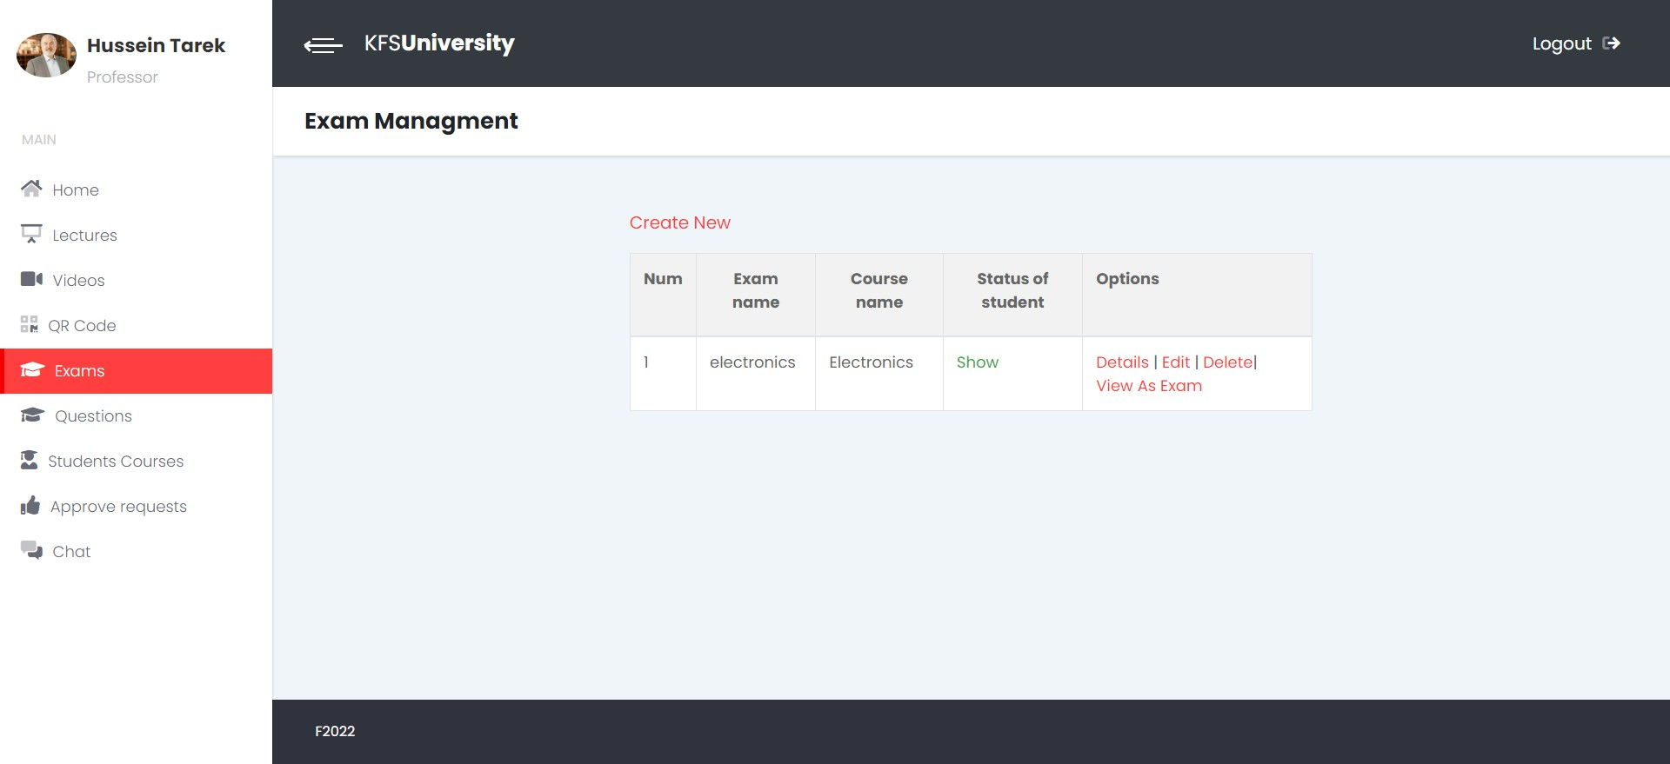
Create An Exam

Slide 29
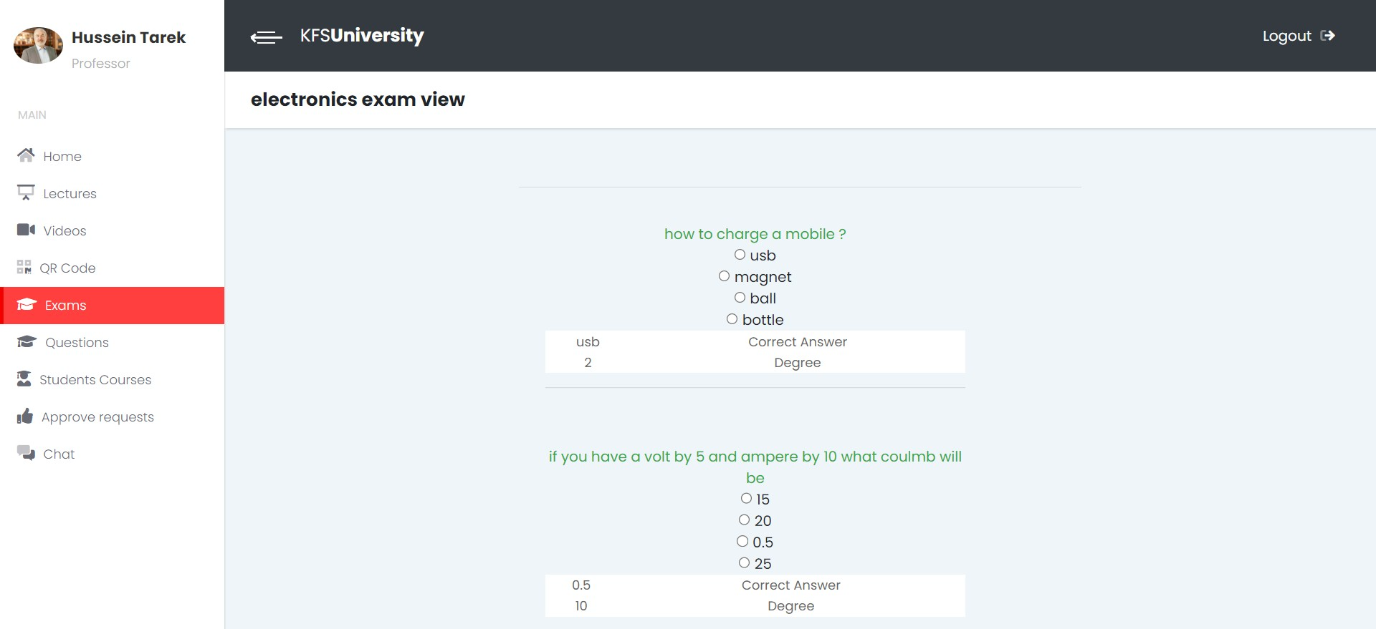
View Exam

Slide 30
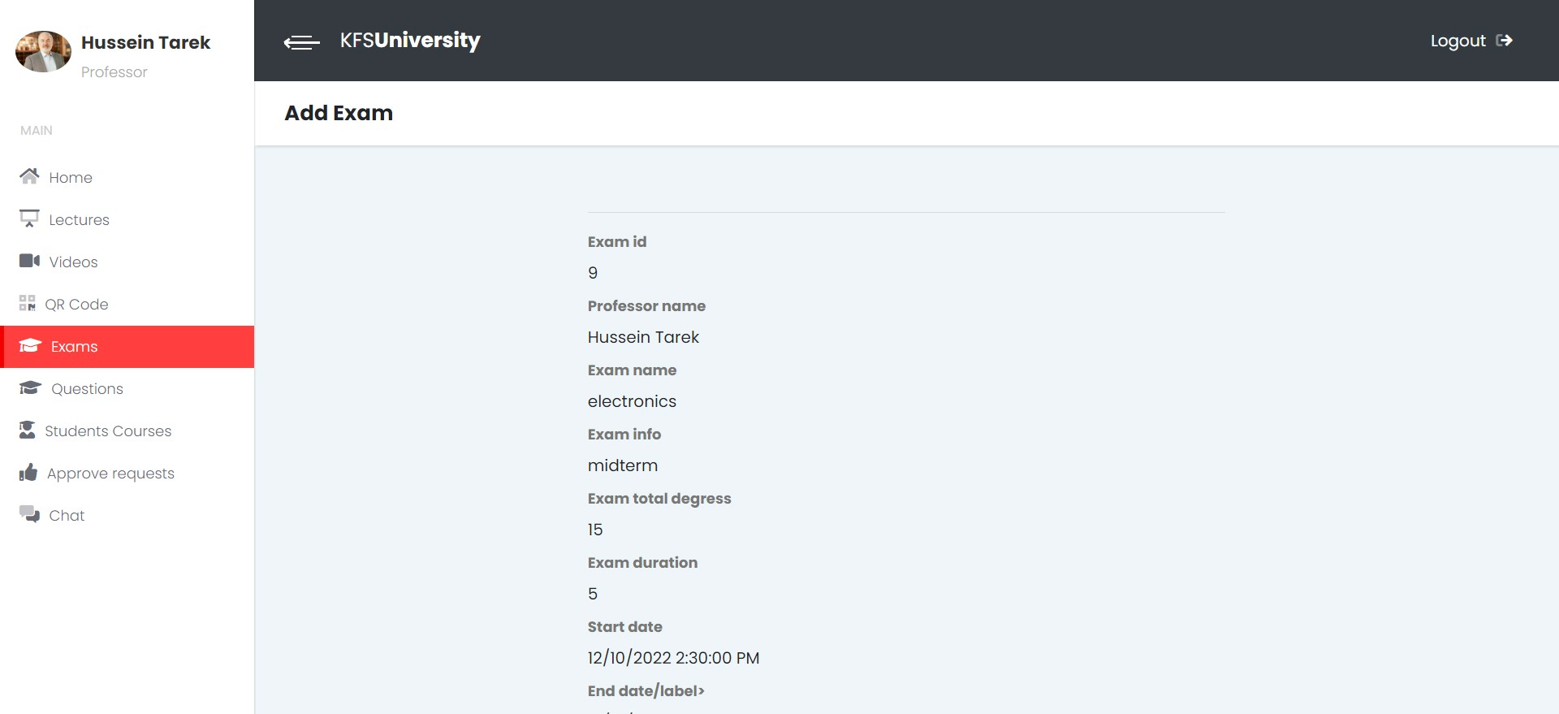
Exam Details

Slide 31
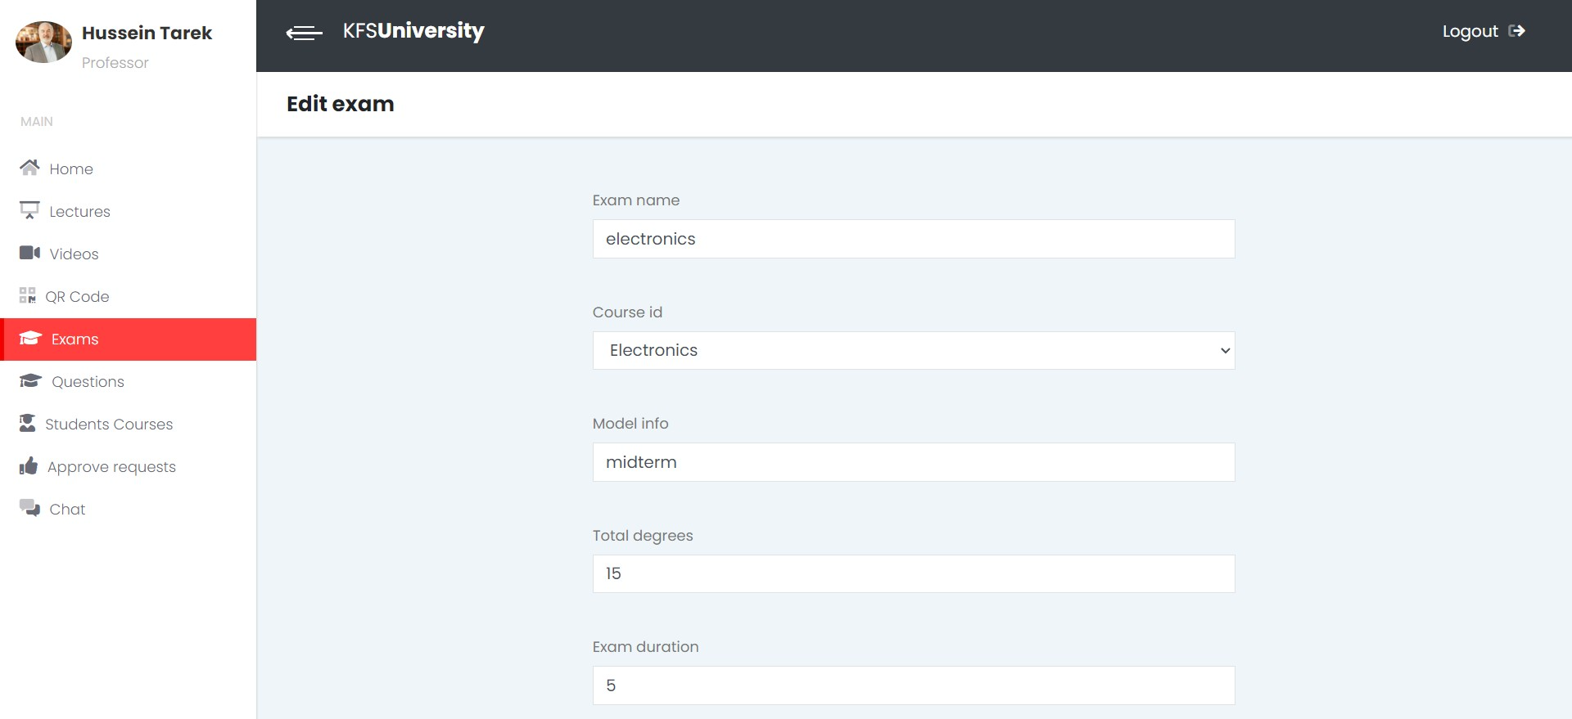
Edit Exam

Slide 32
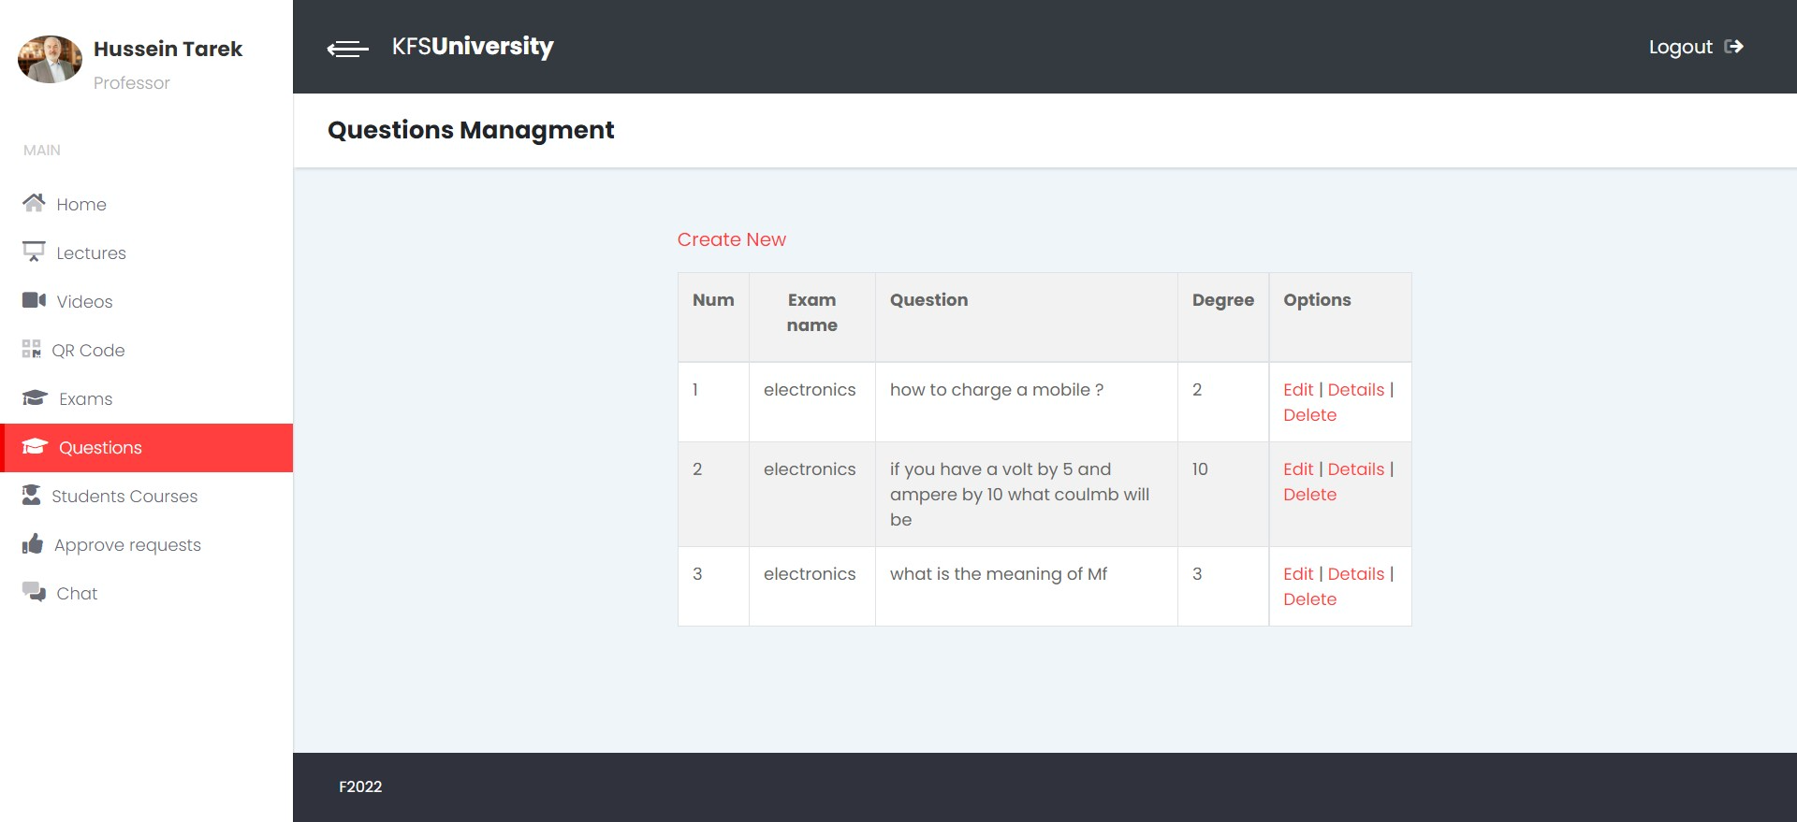
View Question List

Slide 33
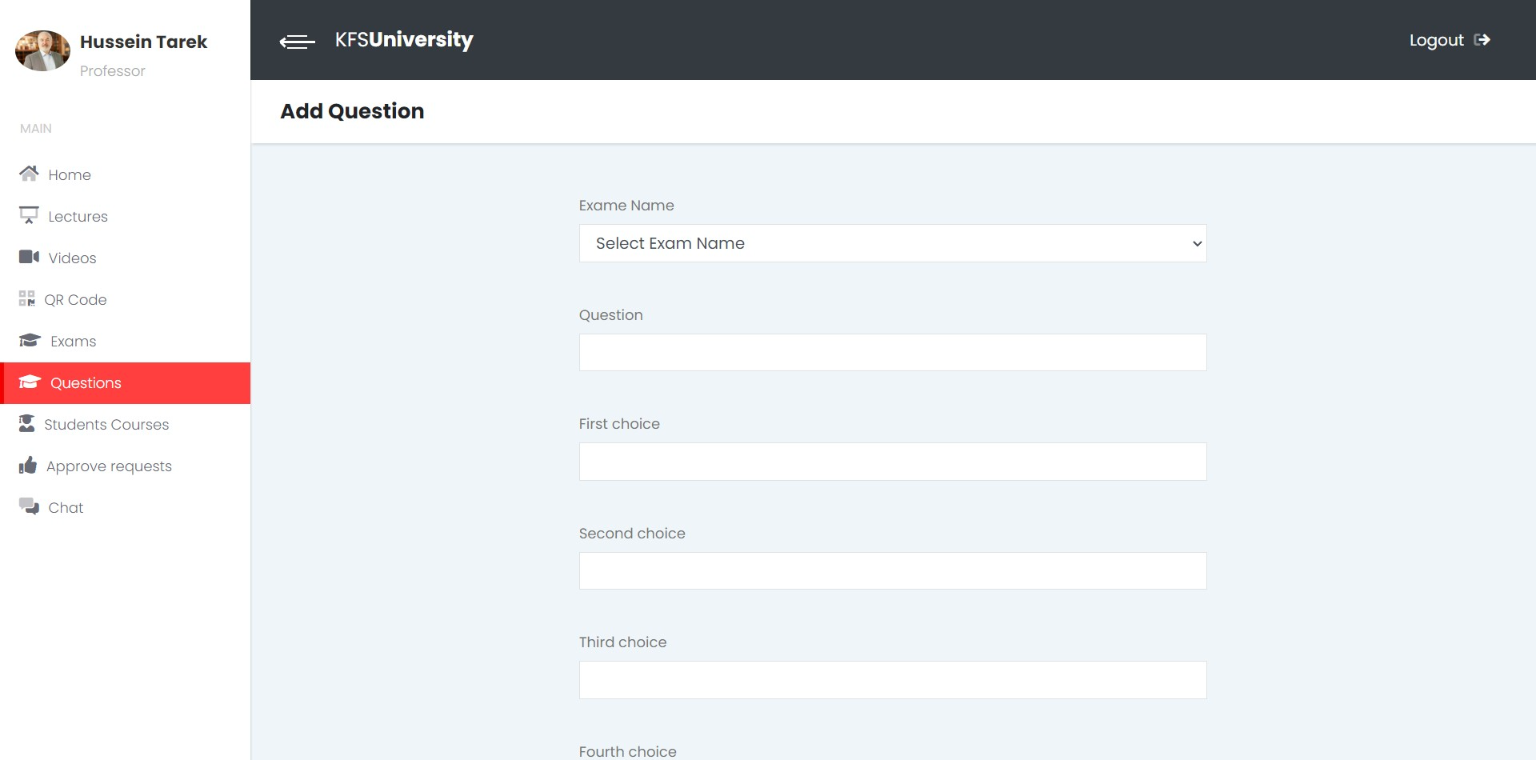
Add Question

Slide 34
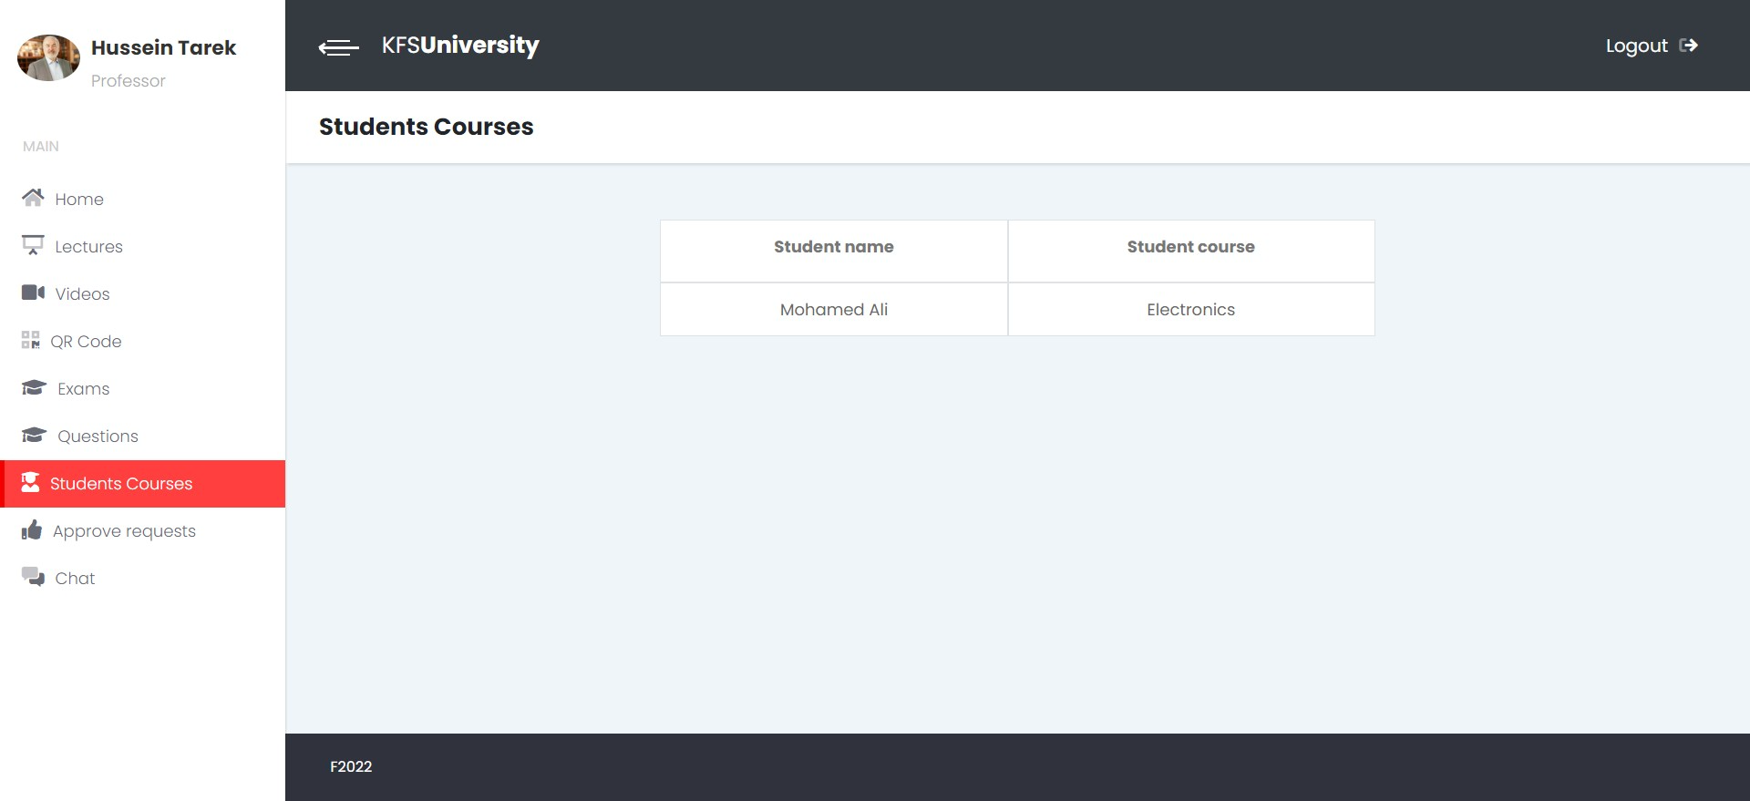
View Student Courses

Slide 35
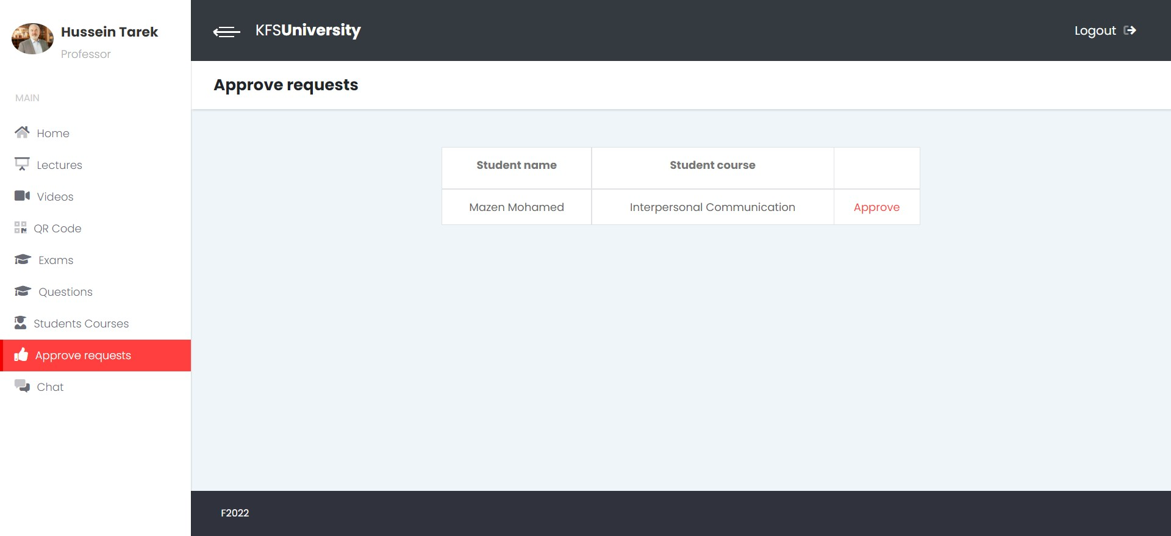
Approve student’s requests for courses

Slide 36
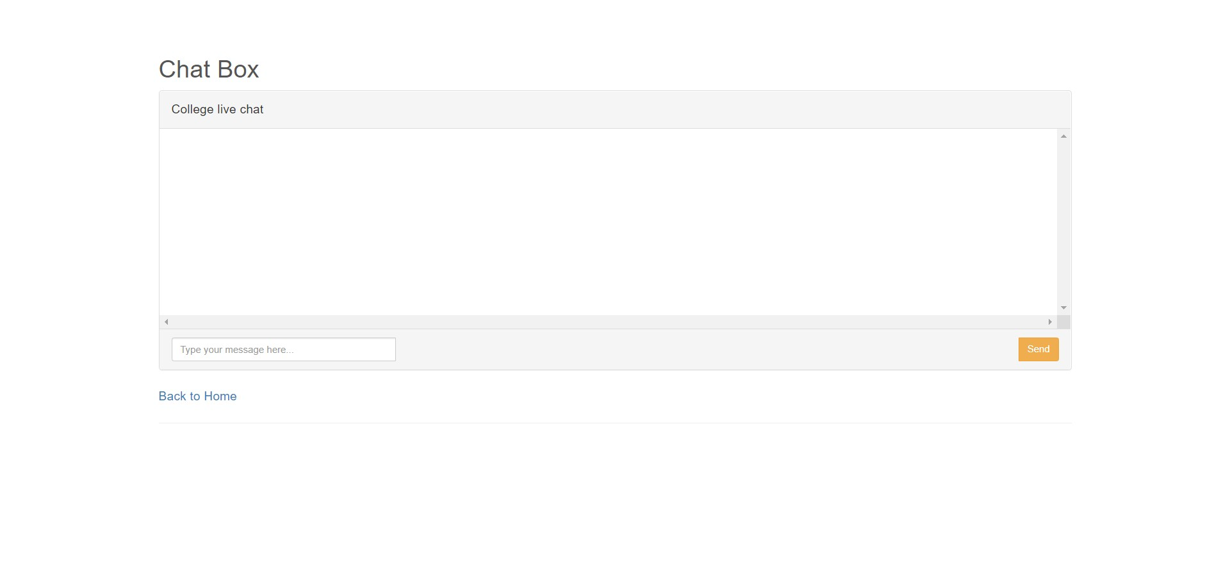
Chat

Slide 37
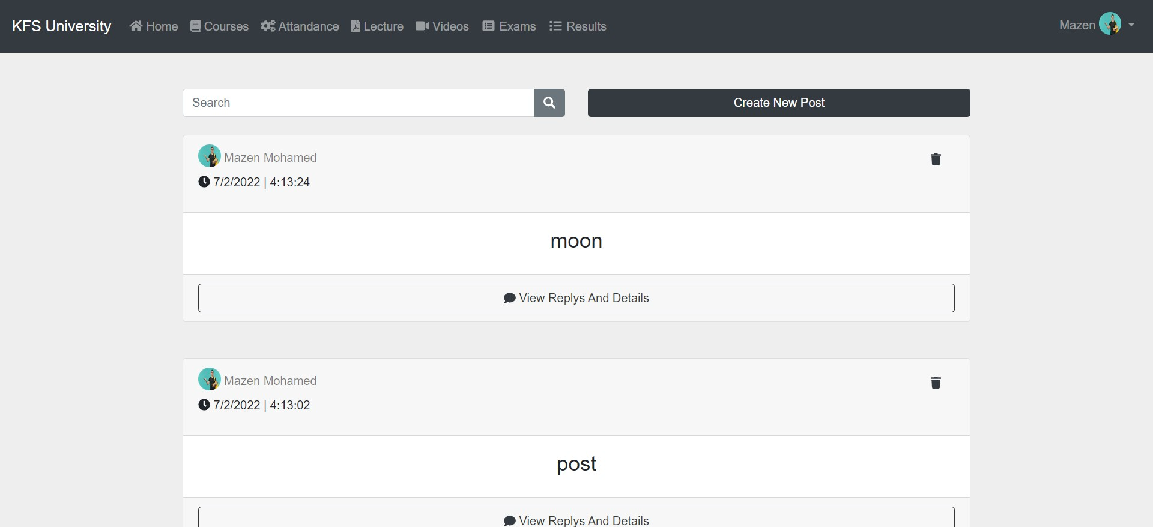
Student Home page

Slide 38
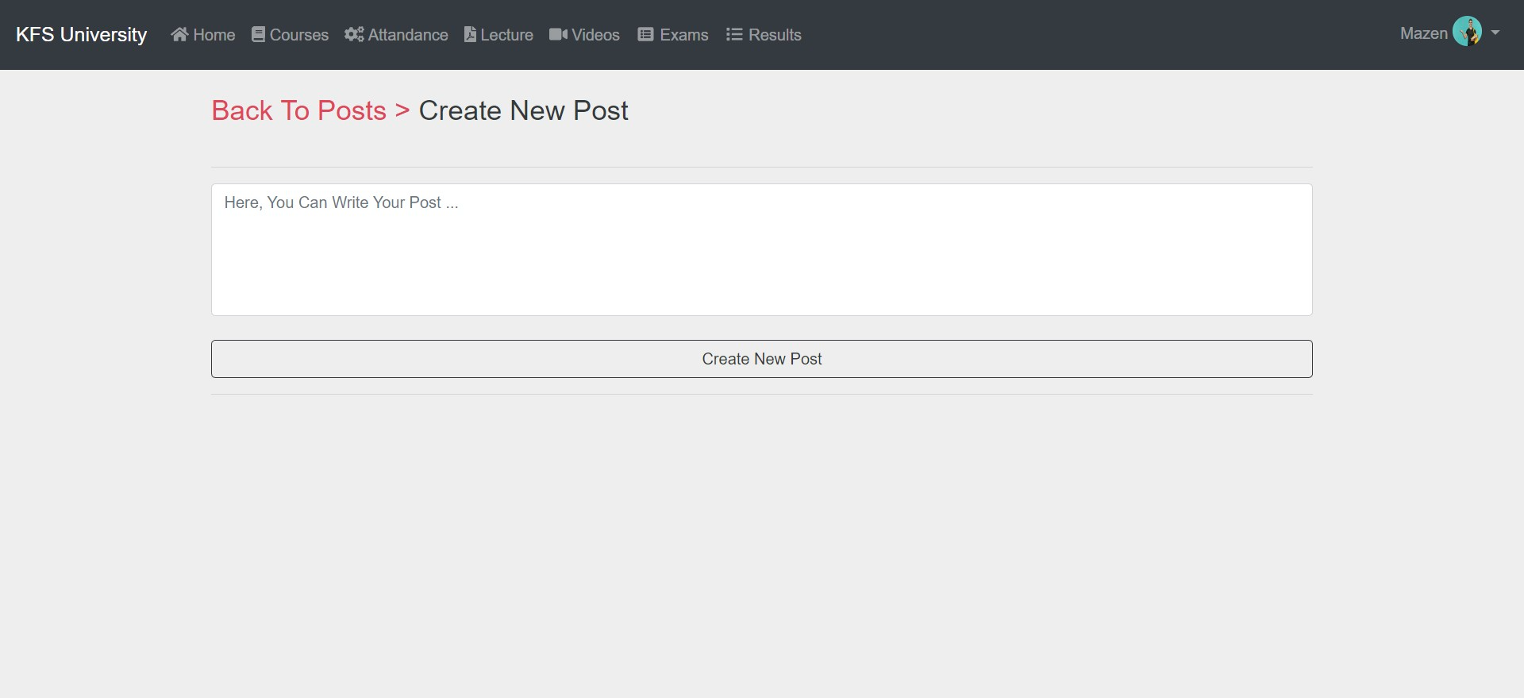
Create Post

Slide 39
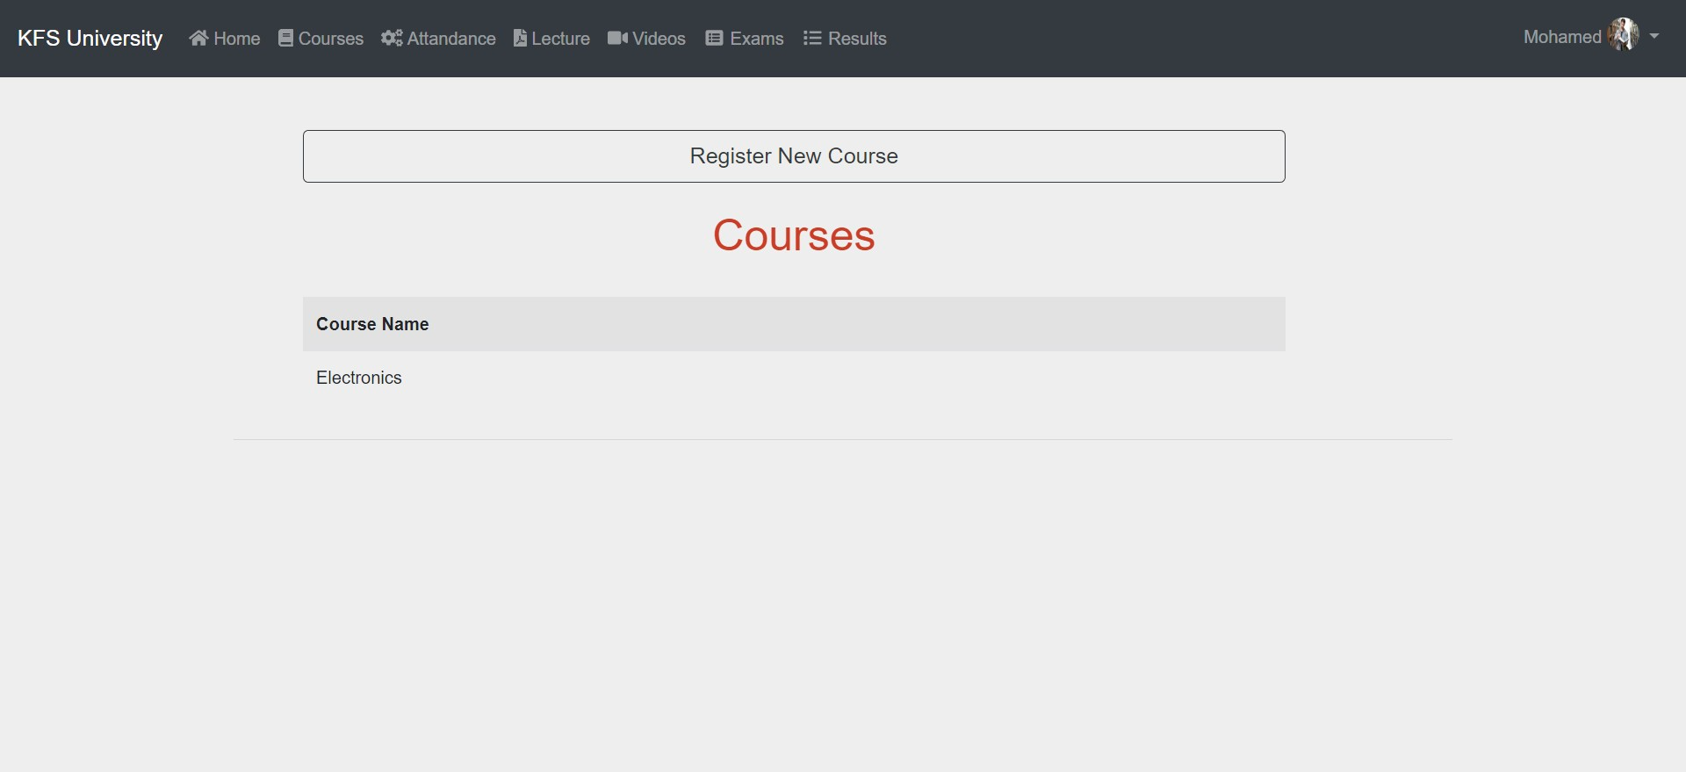
Show registered courses

Slide 40
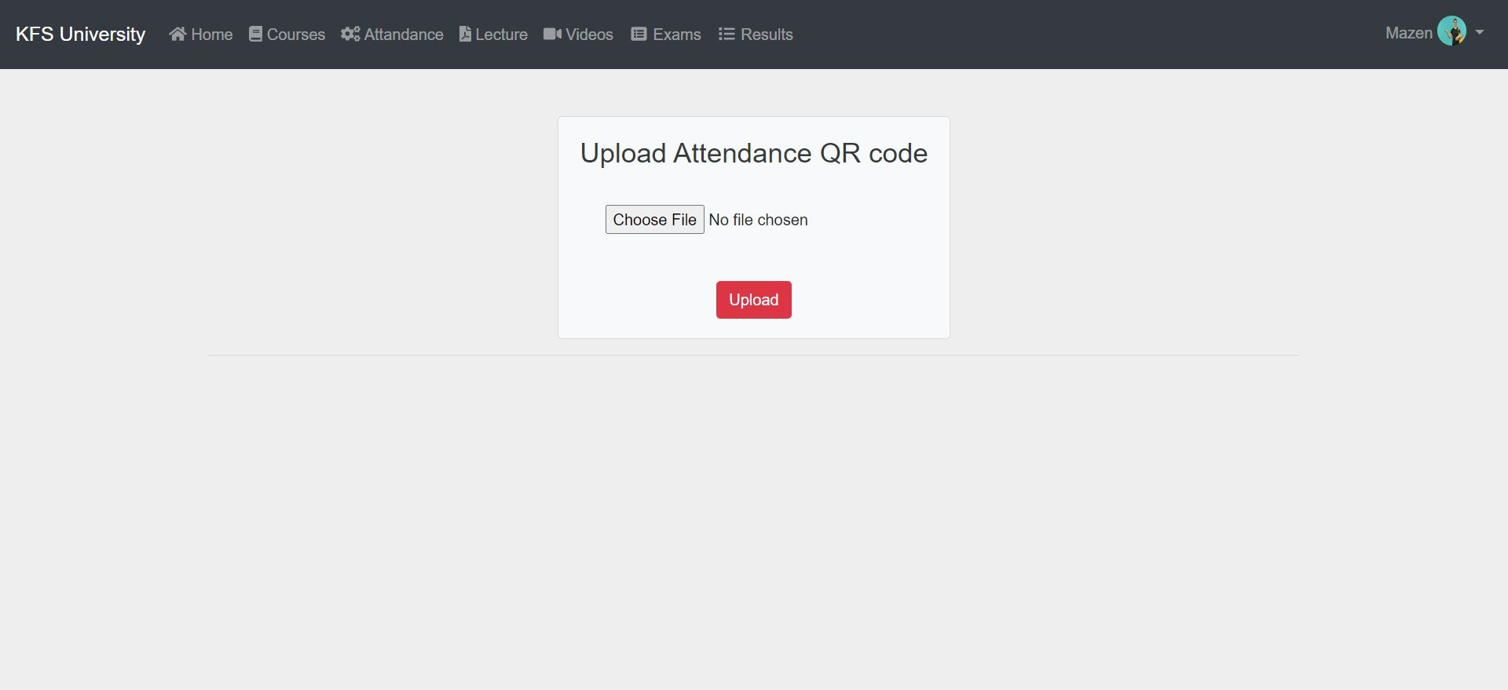
Upload QR Code

Slide 41
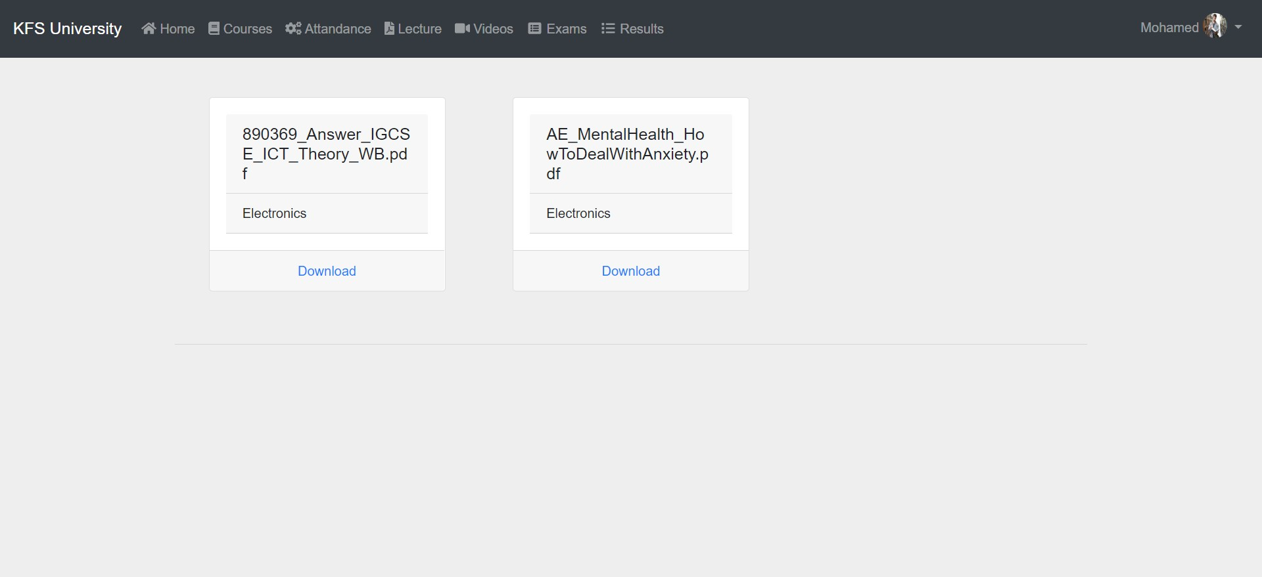
Download Lectures

Slide 42
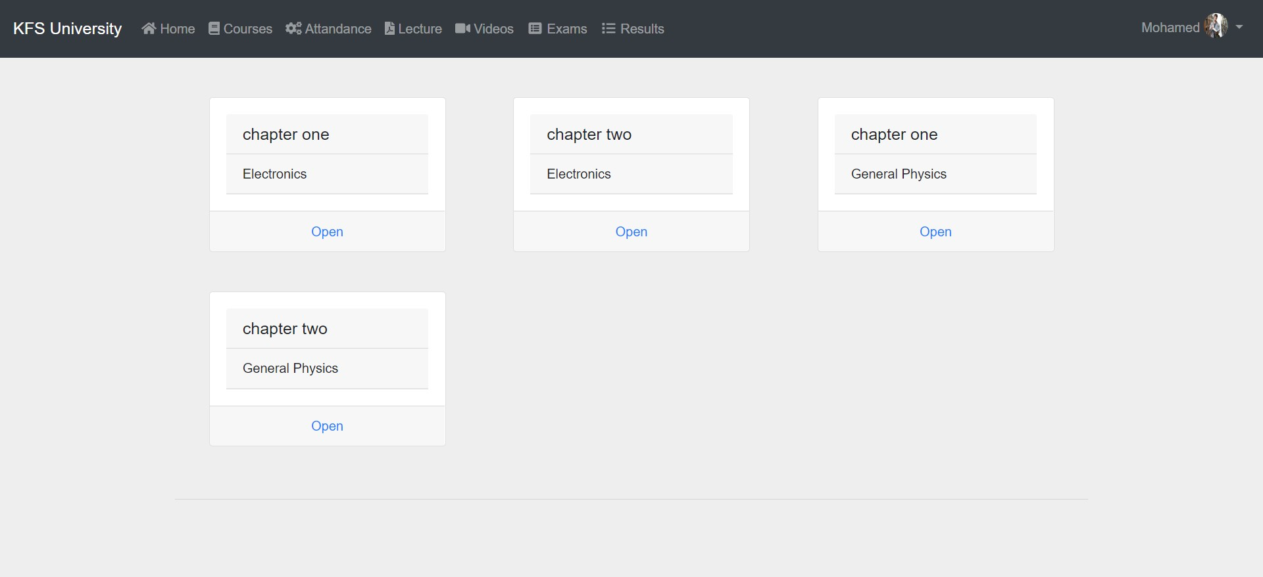
Open Videos

Slide 43

Show Available Exams

Slide 44
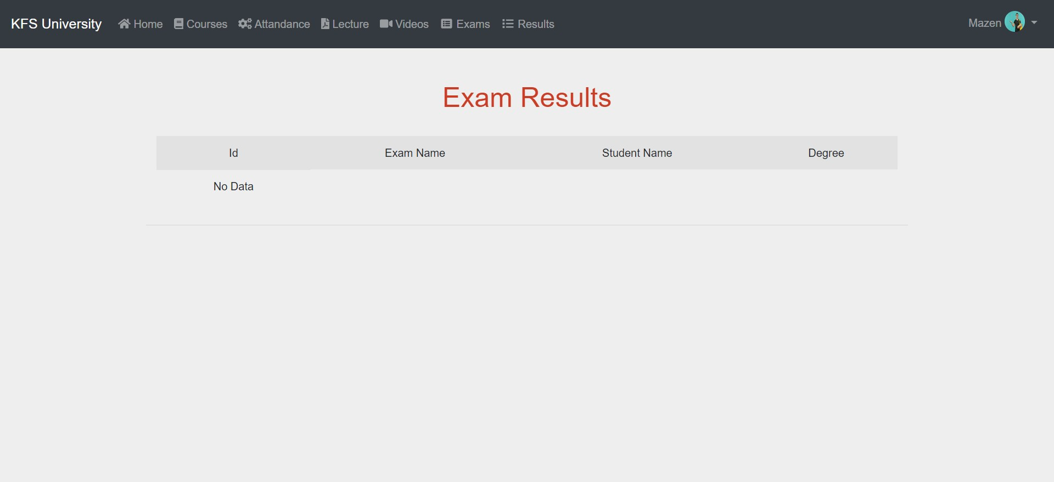
Exams Results

Slide 45
Conclusion
The system multiple advantage, university administration through managing and monitoring and storing students and professors’ data.
Professors will be able to supervise their students and communicate with them easily whatever, by write posts or chatting with them.
Improve students’ educational life and make them able to learn and watch lectures and take exams online.
After developing system “KFS university system” we concluded that it is satisfies the requirement and the objective correctly

Slide 46
Future Work
Making available parking areas for professors within university
Let the parents track the results of students
Let the student take an online certification
Let admin to manage the salary of university fees
Adding payment methods of university fees
Let parent concatenation with other parents.

Slide 47

Thank You

